Slide 1

Inspiring IoT
github.com/bboldi/InspiringIoT
(STUFF)
A Glimpse into DIY Smart Homes
Boldizsár Bednárik
{ Electrical / Software Engineer :: Tech Enthusiast }

Slide 2
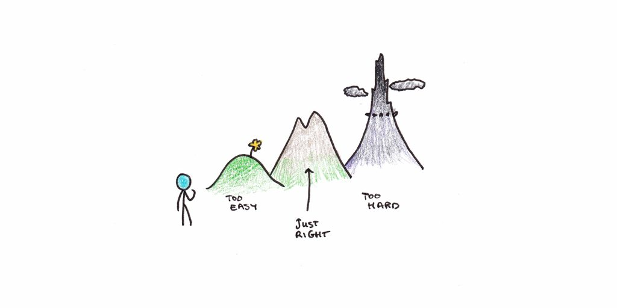
Goals
Inspire, give directions where to start, share experience
Content
Introduction / Little personal history
Out of the box solutions the good the bad and the ugly
Overview of a DIY smart system ( parts, protocols, hardware, software )
NodeRED indtroduction
Data logging and visualization

Slide 3


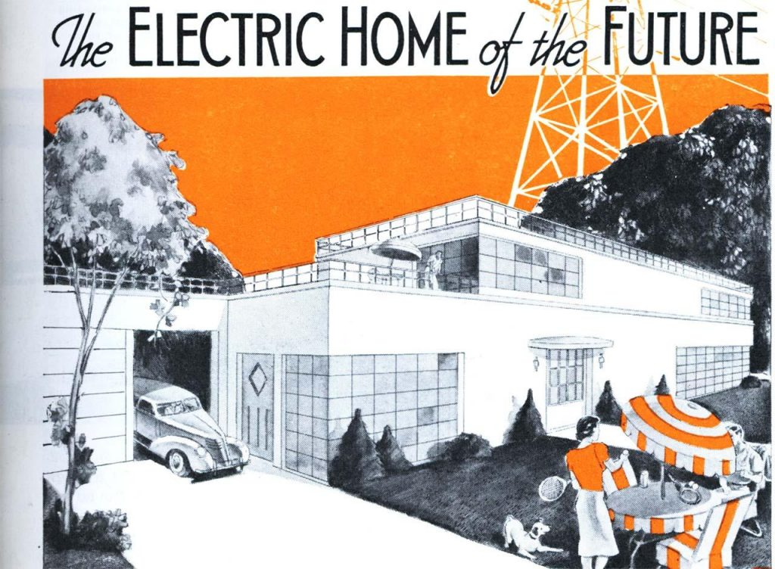
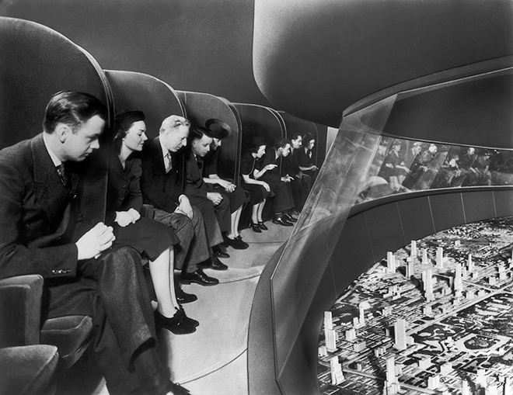

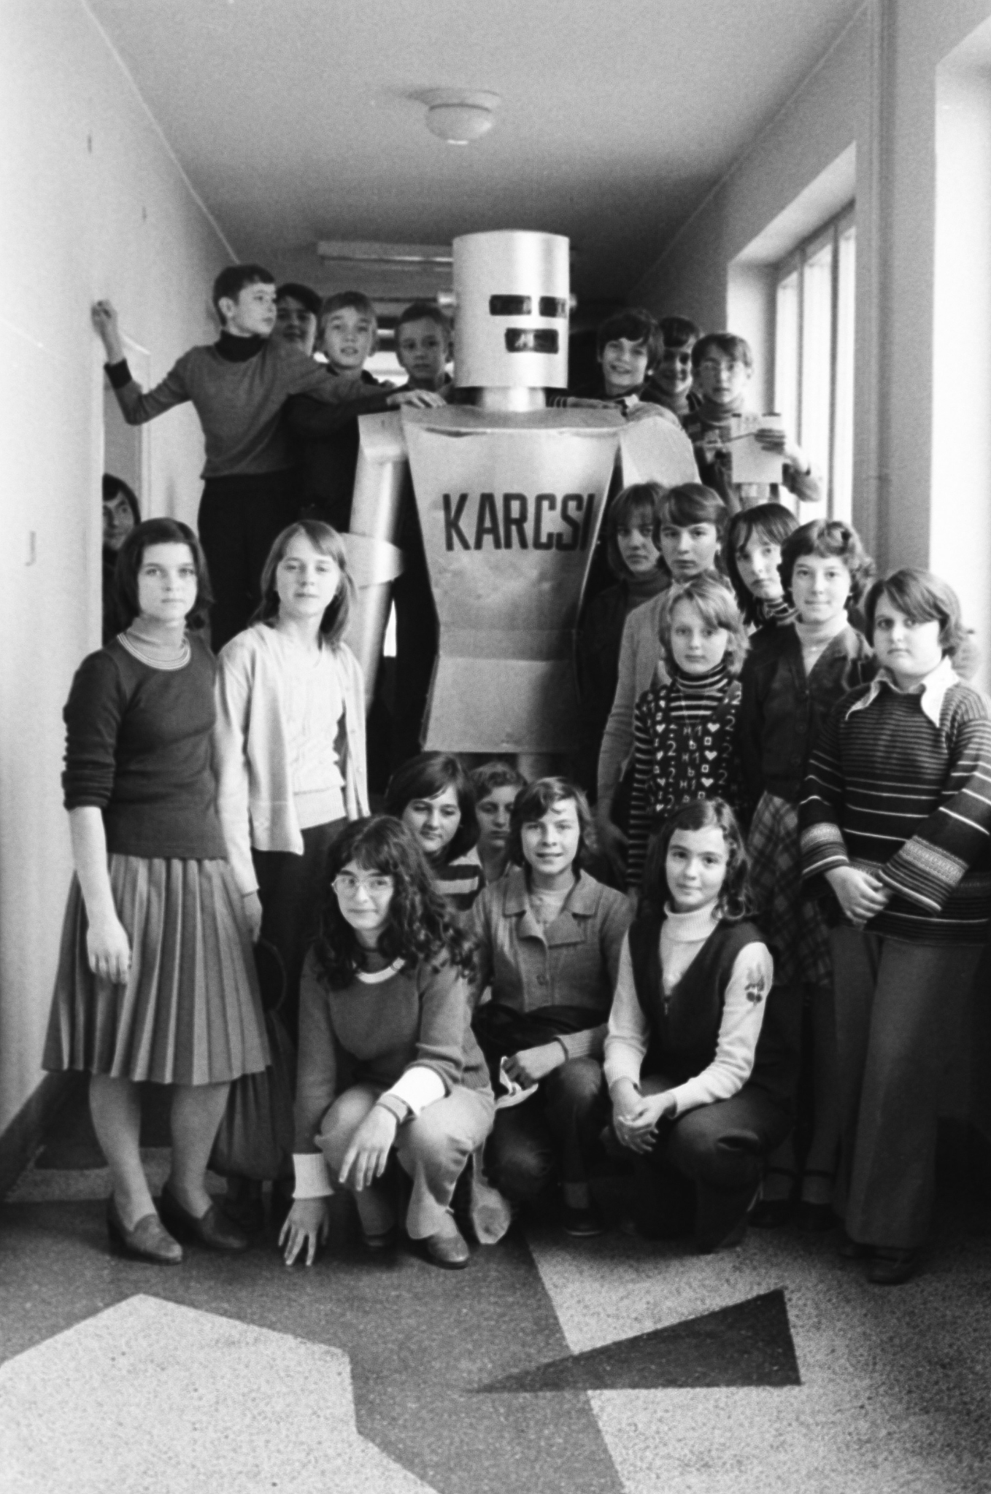





Nothing but a dream …

Slide 4
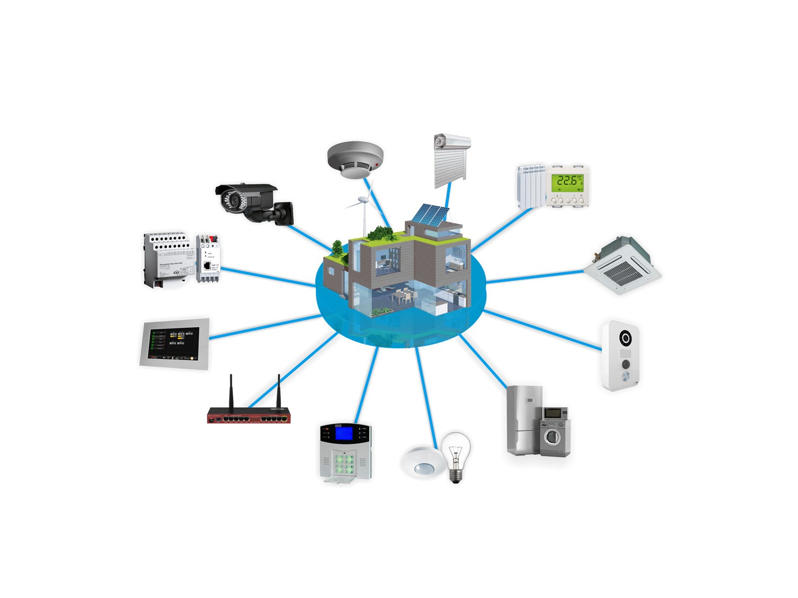
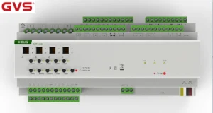
2000s … Getting closer …
European Installation Bus (EIB)
communication protocol
install the necessary wiring and sockets

Slide 5

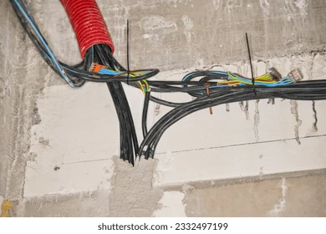

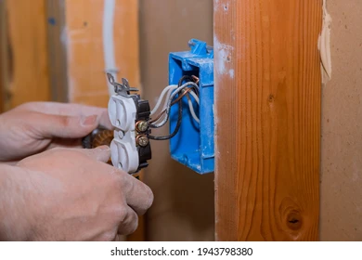
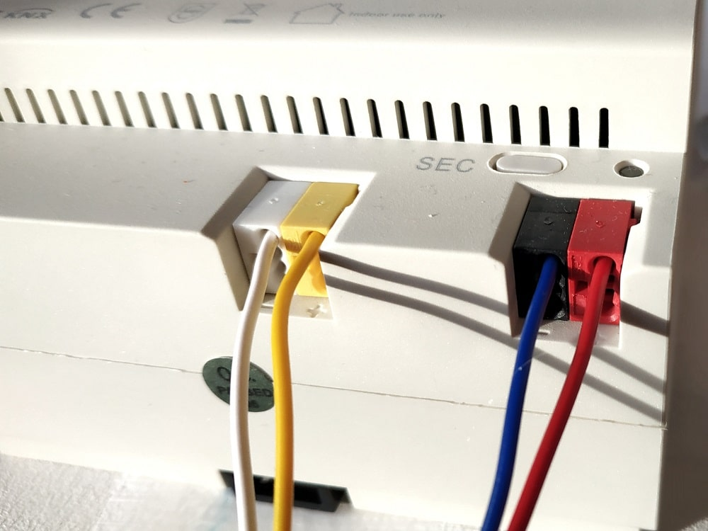
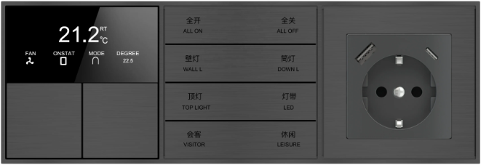
Problems with EIB
$1200
Great! What's the issue? Reliable?
Hell yeah!!!!
Implementation? Price?
$400

Slide 6

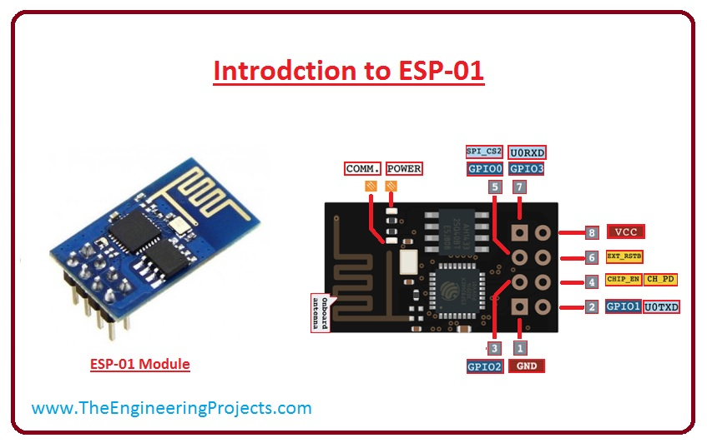
2010s was a good period for DiY
esp8266
ESP-01 , ESP-12
$2 (!)
WiFi
First arduino
Later running code directly
Faster than arduino

Slide 7

Welcome to the world of tomorrow!
Using ESPs for ~10 years in my projects
And you should too!

Slide 8


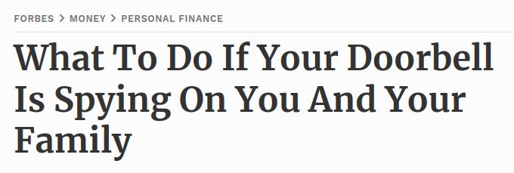
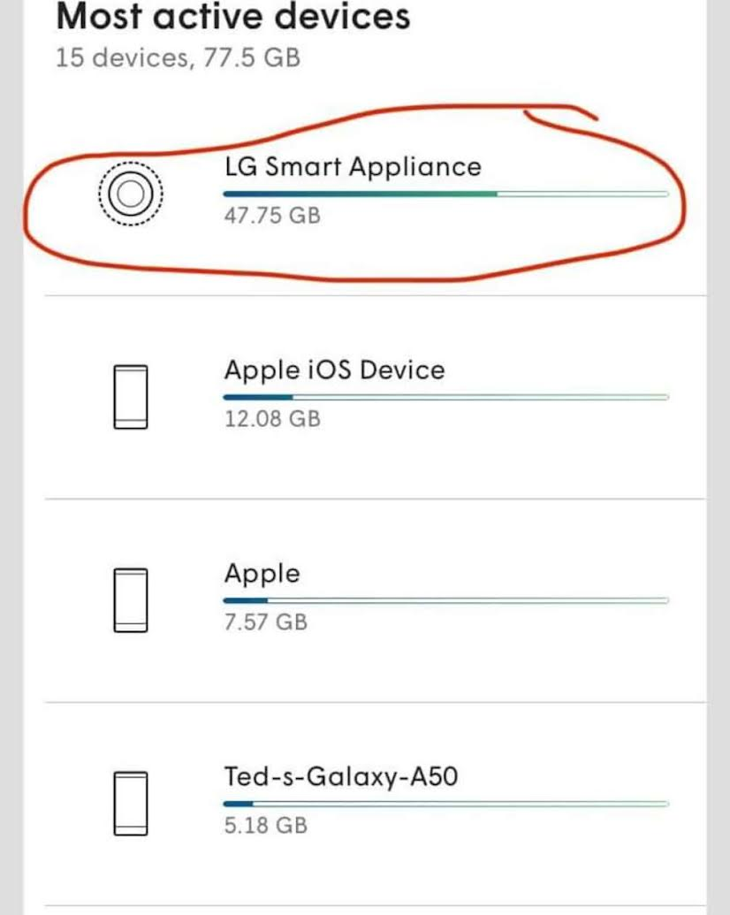
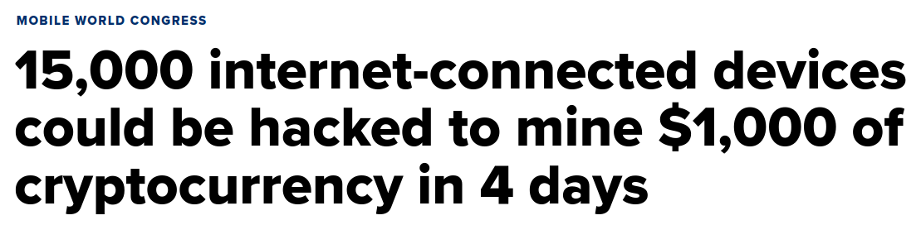
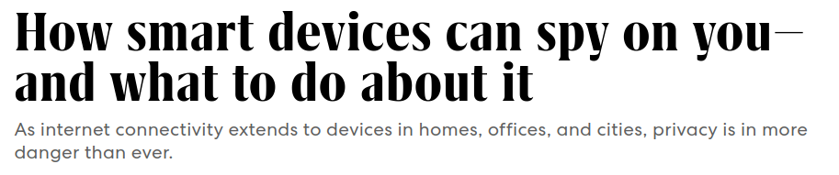
Why Bother?
PRO
Limitless customization
Cost-Effective
Independence from Companies
Price changes, subscriptions
Privacy and Security
Hacking ( zombie devices, spying )
Support ( upgrades )
Constant support from the community
You can learn a TON!

Slide 9
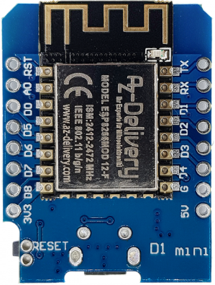

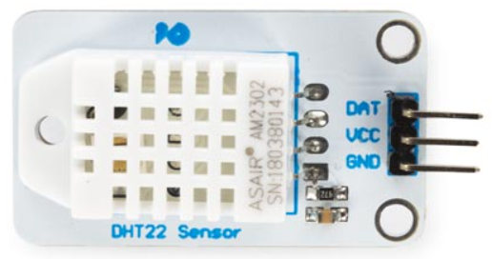

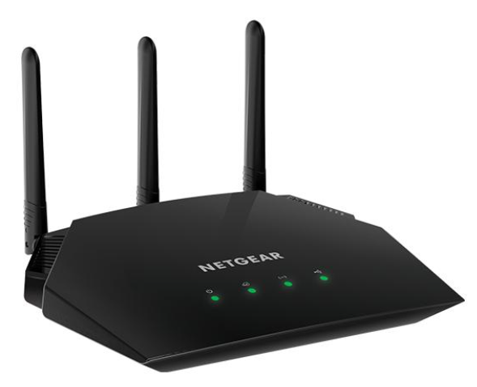
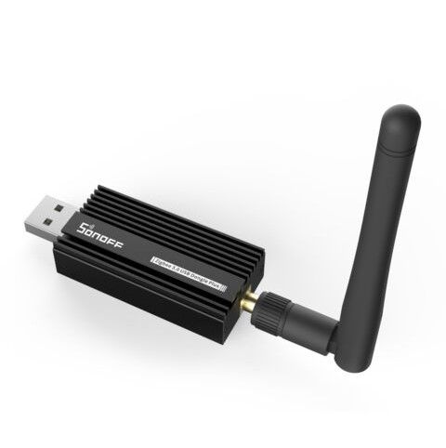




Structure
Nodes
Network (WiFi , Zigbee, etc)
Communication protocol ( MQTT )
Server ( hardware , software )
UI

Slide 10
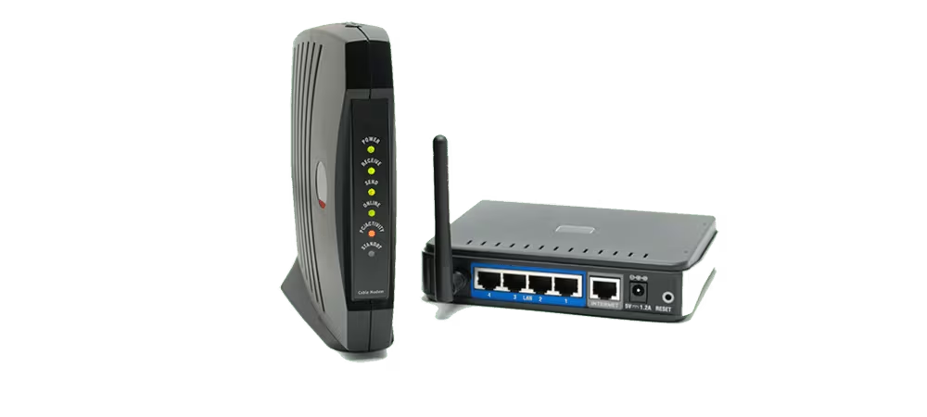
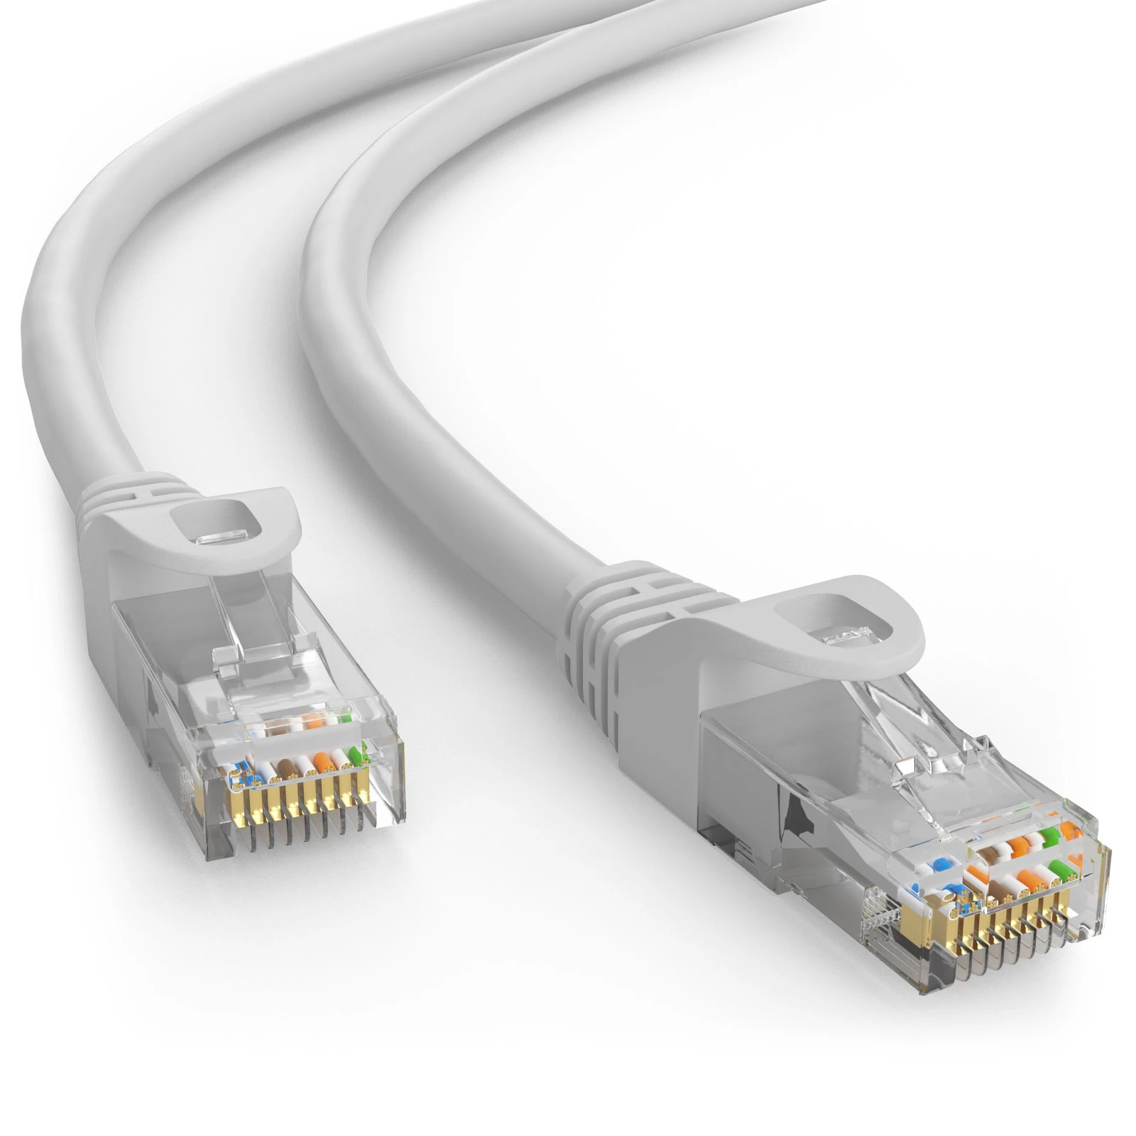
Network
WiFi
Router
2.4 GHz
Zigbee
Router ( well … kind of )

Slide 11
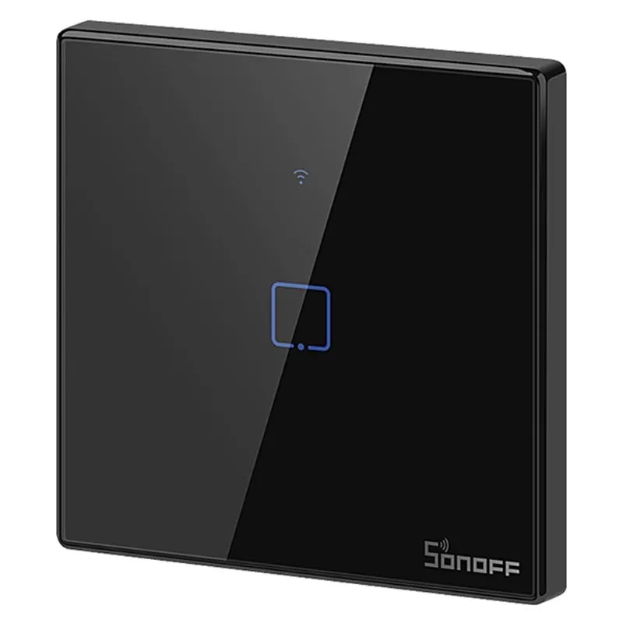
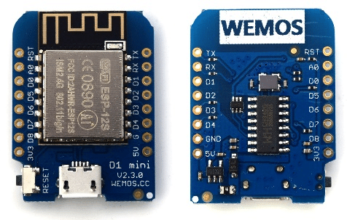
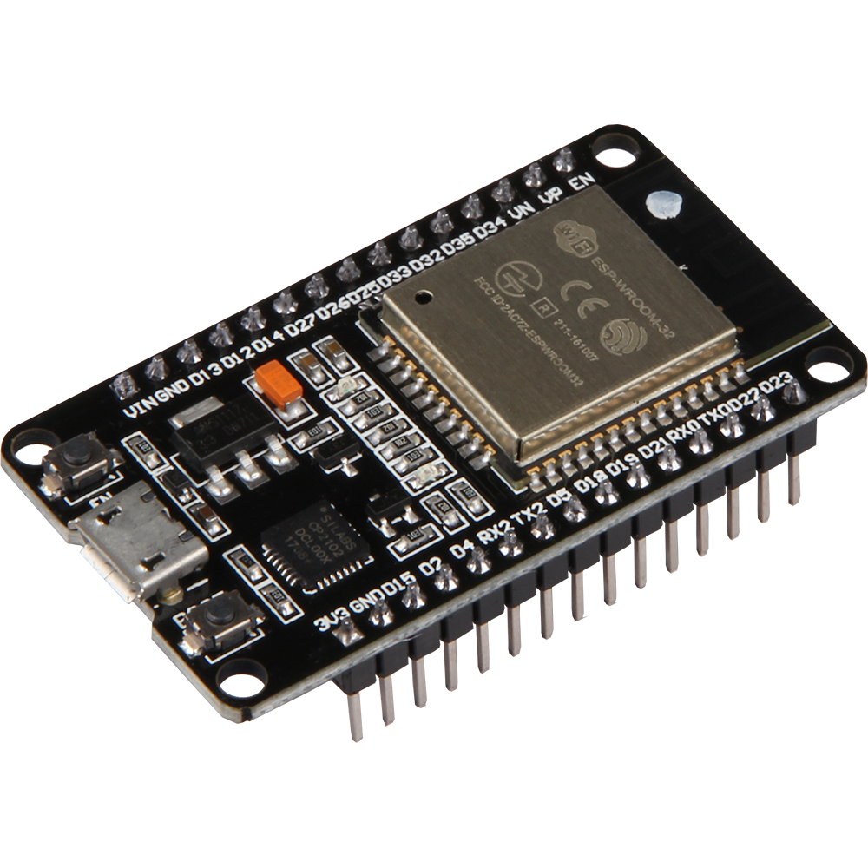
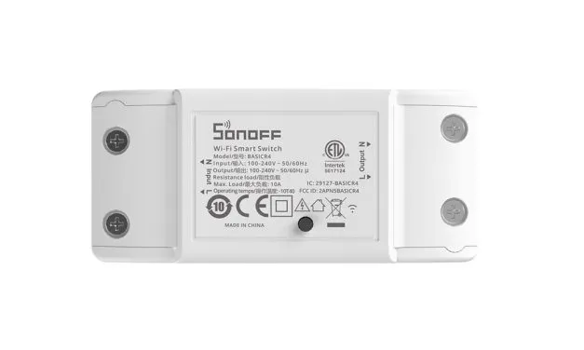
WiFi Nodes
Hardware
DIY
ESP8266 or ESP32
WemosD1 mini ( 8266 / 32 )
Off shelf ( moddable )
Sonoff, athom.tech
RF wifi bridge ( sonoff ) (!)
Software
DIY - write your own firmware in C
Use open source
EasyESP, EspHOME, Tasmota
Why not Raspberry pi for nodes?

Slide 12

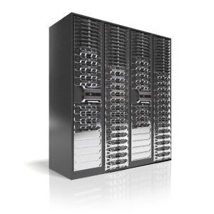
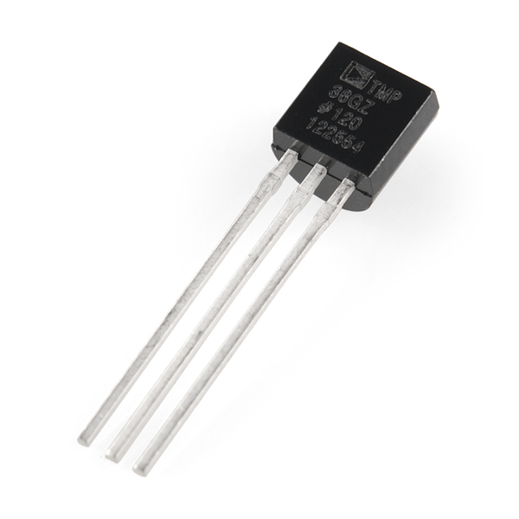

"Why not use raspberry pi?"

Slide 13
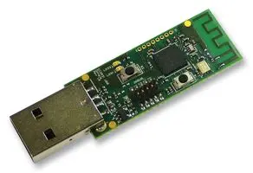
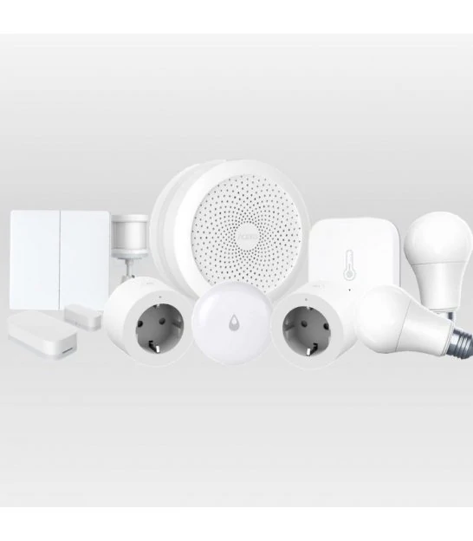

Zigbee Nodes
CC2530
Problems with 2.4GHz Wifi network
Zigbee Great Option!
DIY I don't think so …
Out of the box
No modding needed
Easy to connect to server
Cheap
No installation
Battery lasts forever
Zitbee2MQTT

Slide 14
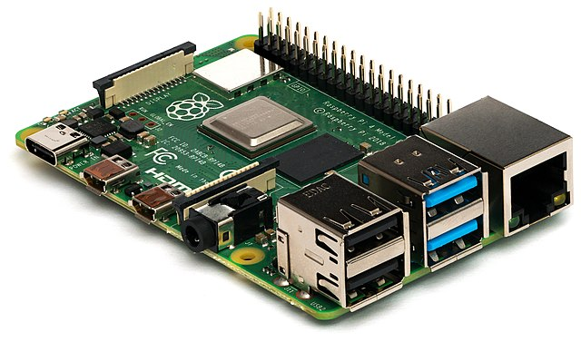
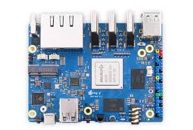
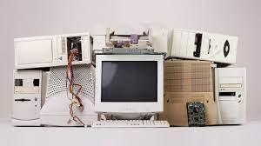
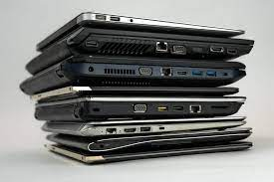

Server - Hardware
Ideally a dedicated hardware, but can be a virtual machine on your home server ( if you have one )
Heart and soul of the Smart System
Raspberry Pi, Orange Pi, Banana Pi
Old PC / Laptop lying around
Cloud ( Linode , Digital Ocean, Hetzner )

Slide 15



Server - OS ( btw I use Arch )
Windows? Might work … overkill TBH
Linux is King!
Small, snappy
Made for this - BEST for open source
It's FUN
Huge learning opportunity ( resources, tutorials, ChatGPT )

Slide 16


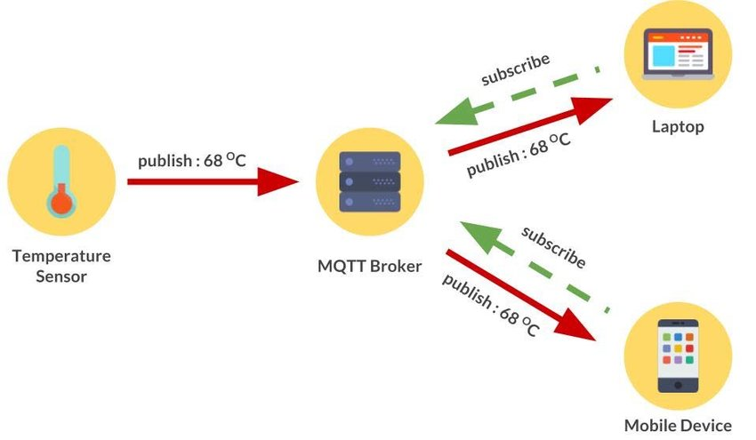
Communication Protocol : MQTT
Message Queuing Telemetry Transport.
Special language devices use to talk
Small data packets/ header compared to http
Broker - Clients
Topics: Subscribe / Publish
Very efficient for small data packets
QOS
Mosquitto - open source

Slide 17


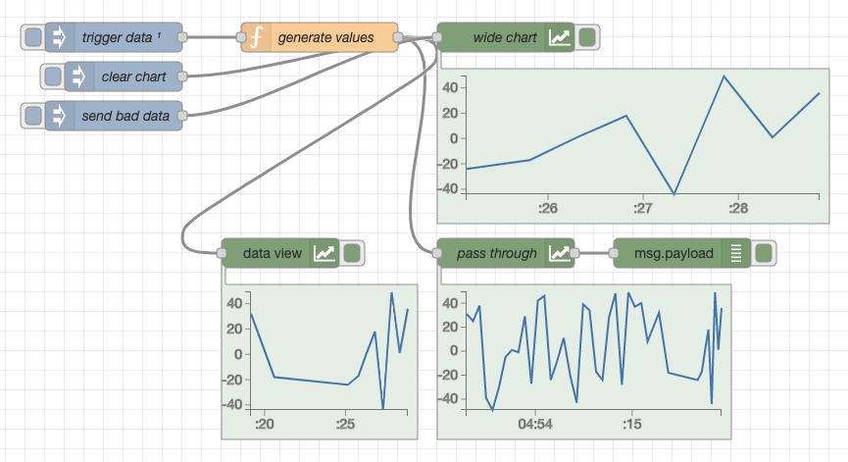
NodeRED
10C
"Brain" of the smart home
Alternatives: Domoticz, Home assistant, etc
My Personal preference
Flexible
Digital "lego" pieces called nodes
Data flow interaction

Slide 18
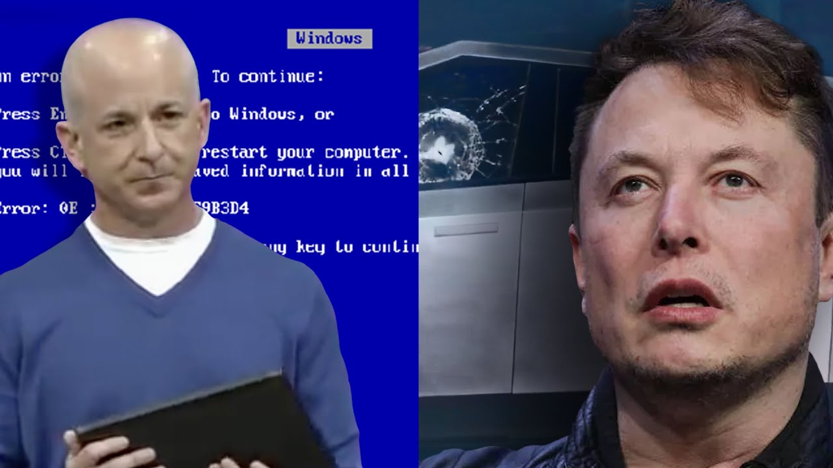
NodeRED - DEMO

Slide 19

Logging and Visualization
Why?
Monitoring, Logging, Keeping values
Visualization of data
Can NodeRED do this?
InfluxDB + Grafana

Slide 20

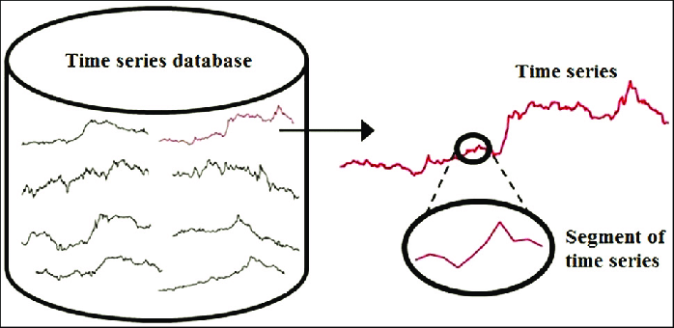
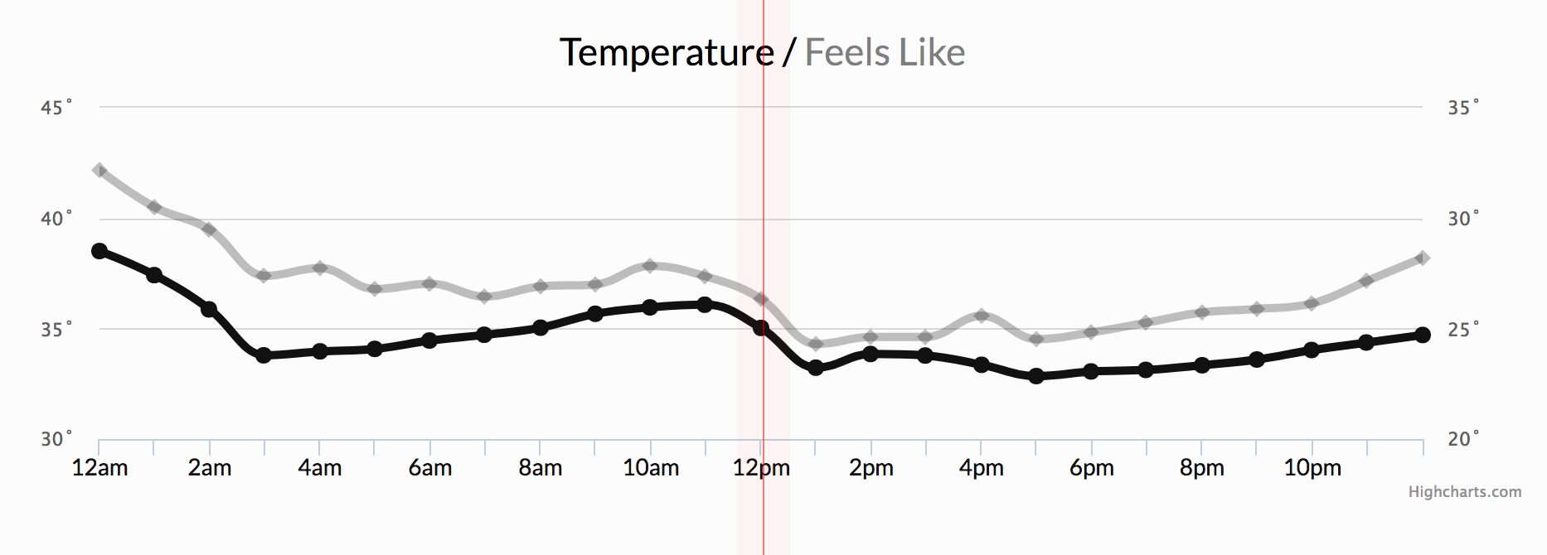
Logging: InfluxDB
Time series database
Designed to store / manage data that changes over time
Plays nicely with NodeRED
It has a query language, hard to visualize

Slide 21

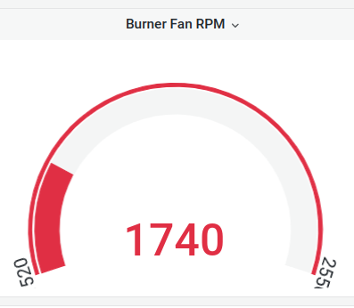
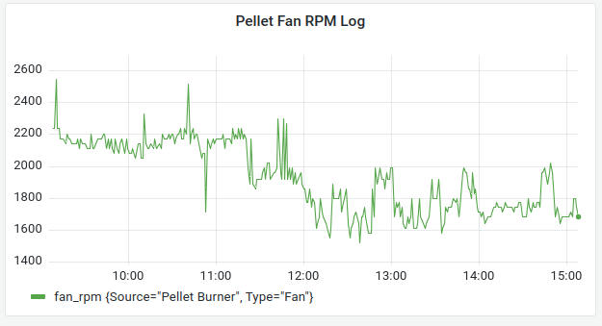
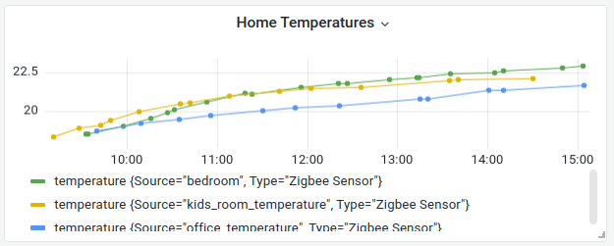
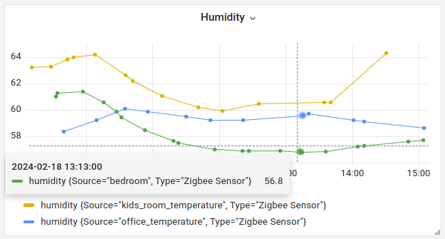
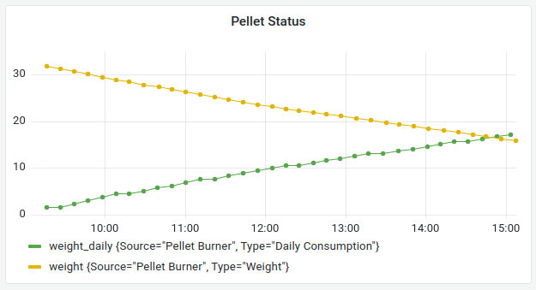
Visualization: Grafana
Native support for InfluxDB
Superb visualization
Dynamic dashboard
Alerting ( notifications, alerts, real time monitor )
You can connect other sources and visualize them on same dashboard

Slide 22

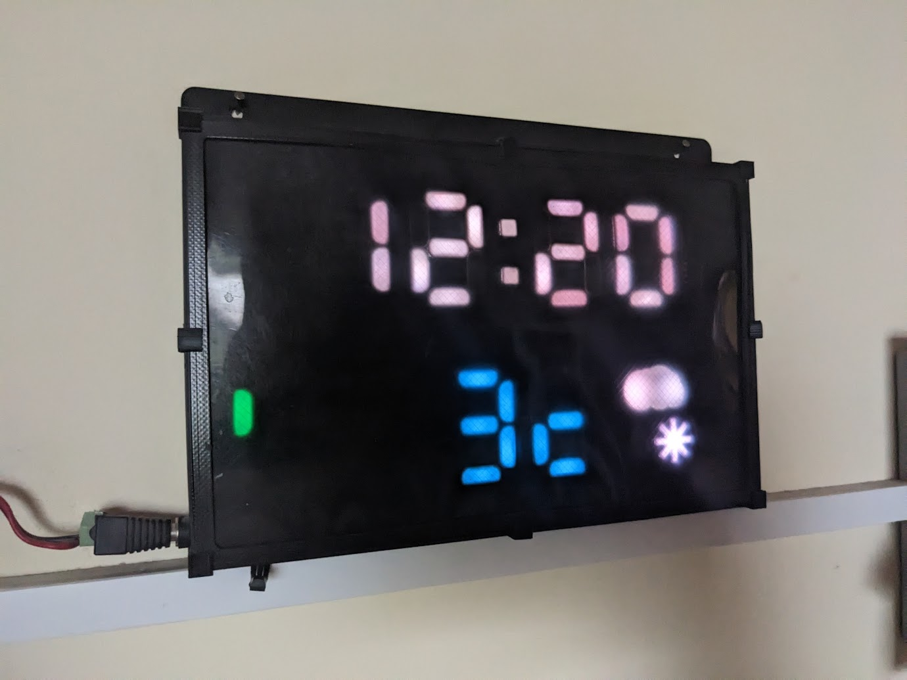
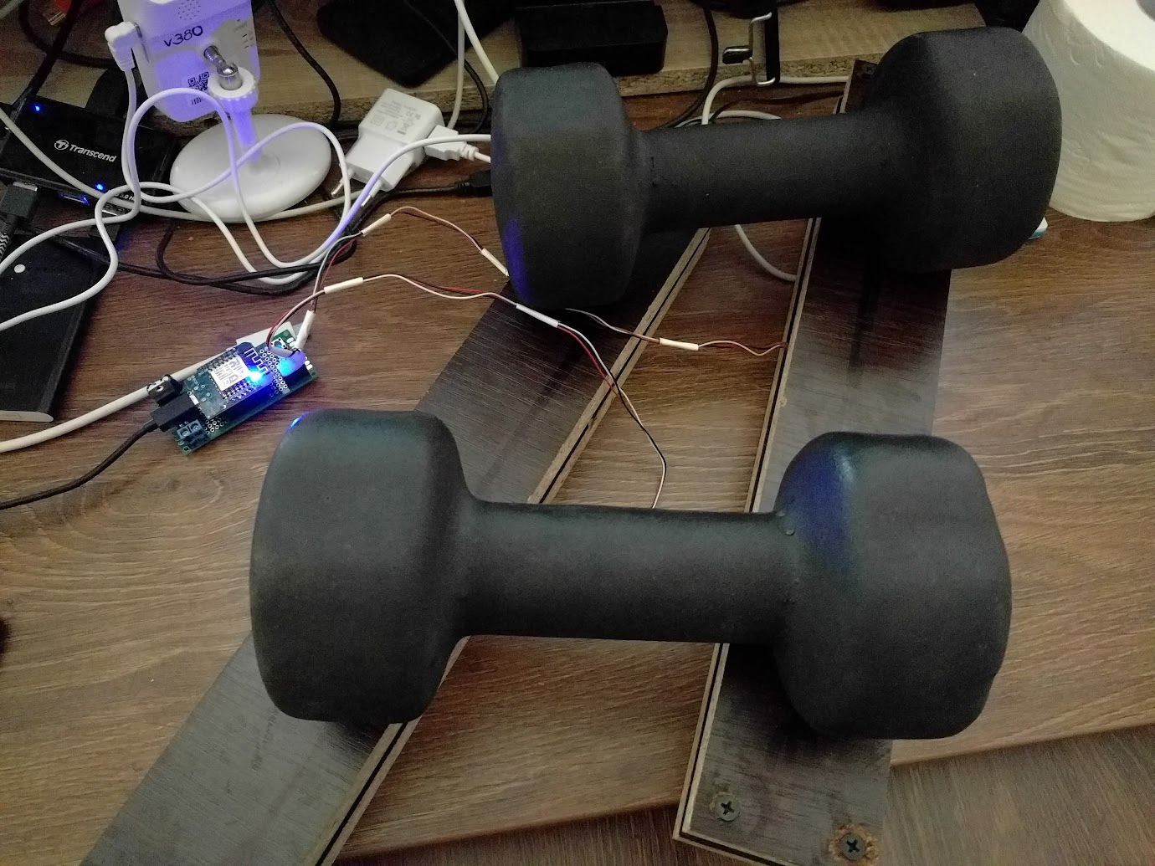
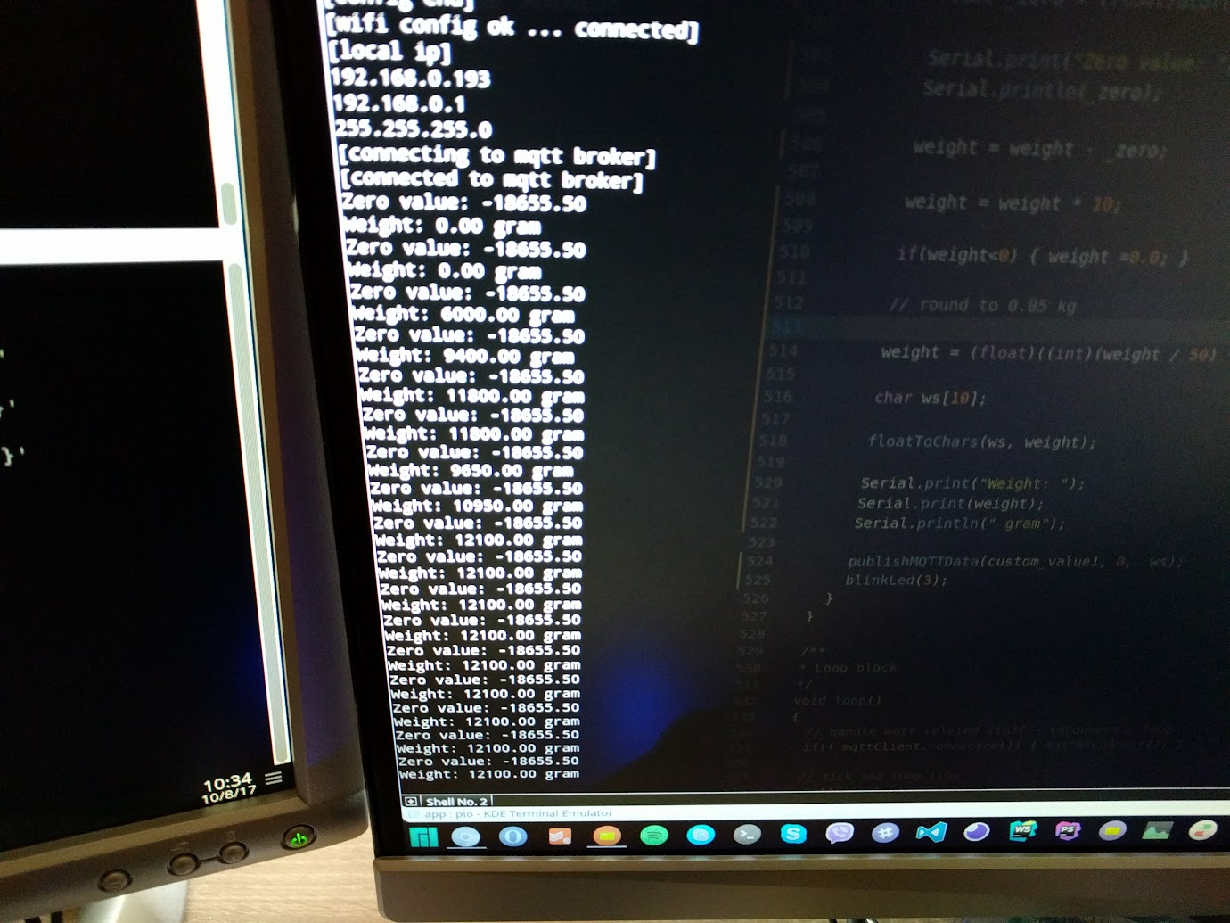
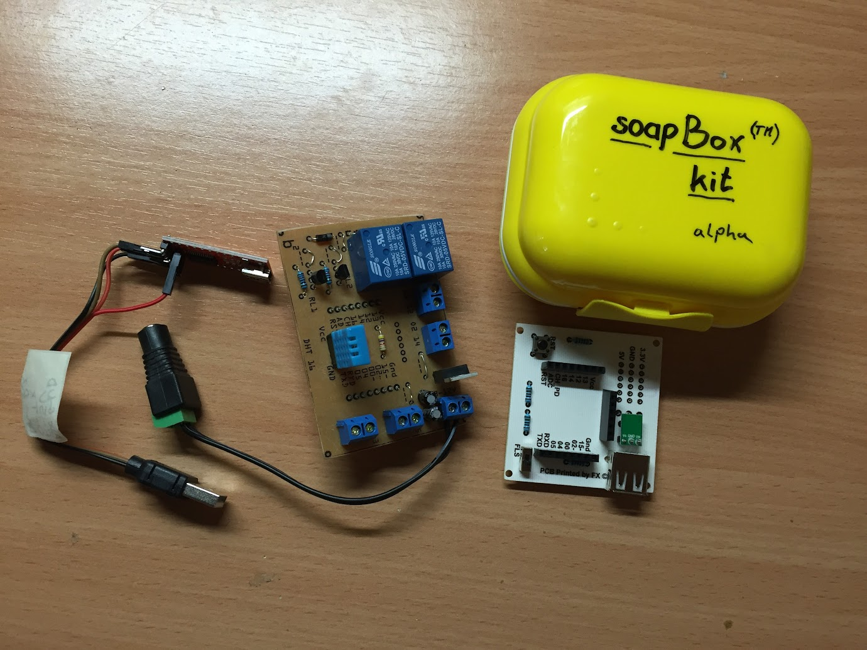
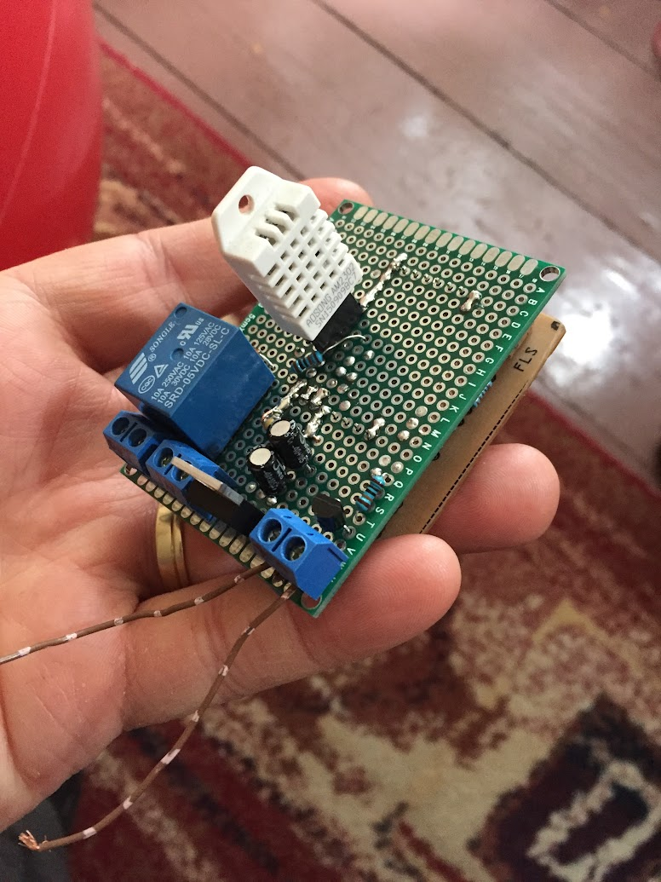
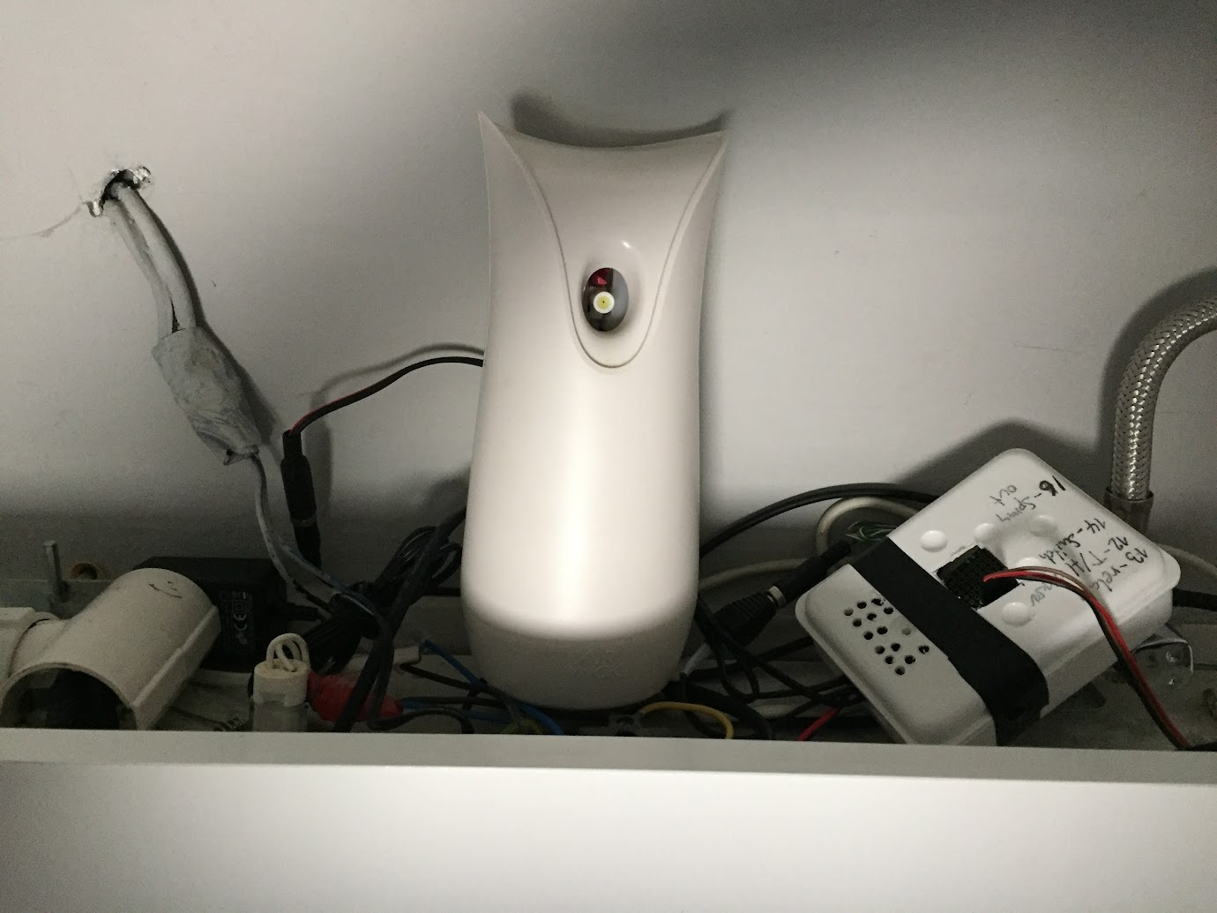
My Experience …
Smart home hacking 10y , made lots of stuff
ESP , Zigbee + Open Source is reliable!
Except when it's not
Advice:
use with caution for critical stuff
always have a backup solution ( drop in replacement for heating, etc )
implement failsafe ( physical thermostat for overheating )
backup your data :) you might need it later!

Slide 23

Examples, ideas
Heating , Cooling control depending on outside weather
Alarm system ( motion sensors, door sensors, detect who's home, presence detection , schedule )
Access control for your home with NFC, Moblie or Fingerprint
Smart home dashboard using old phone and node red dashboard
Automated curtain operation
Automated RGB light control ( wake up with light )
Connect camera system with your smart home ( rtsp with node red , save images, send it through )
Send notifications to phones ( Pushbullet, Pushover, etc )
Detect problems, like leakage and fire
Create your own voice assistant ( there's os alternative )
Connect everything with OpenAI ( chatgpt )
Endless possibilities …

Slide 24







Thanks! Questions?
FEEDBACK
@bboldi
bbednarik@gmail.com
@bboldi
bboldi.com
https://www.youtube.com/@hellomakers

